Slide 1
Longevity/Mortality Risk Modeling and Securities Pricing
Patrick Brockett, Yinglu Deng, Richard MacMinn
University of Texas at Austin Illinois State University

Slide 2
Introduction
Background
Data Description
Model
  Model Framework and Requirement
  Model Specification
Numerical Calculation
  Parameter Calibration
  Model Comparison
  Implied Market Price of Risk
  Example: q-forward Pricing
Conclusion

Slide 3
Longevity Risk
Definition
Dramatic improvements in longevity during the 20th century
  In developed countries, average life expectancy has increased by 1.2 months per year
  Globally, life expectancy at birth has increased by 4.5 months per year
The impact of the longevity risk
  In U.K., double the aggregate deficit from £46 billion to £100 billion of FTSE100 corporation pension
  In U.S., the new mortality assumptions for pension contributions, increase pension liabilities by 5-10%
  up-to-date mortality tables, pension payments, increase 8% for a male born in 1950
  Participants
  Pension funds
    Corporate Sponsored
    Government Sponsored
  Annuity Providers
    Insurance companies
    Reinsurance companies

Slide 4
Mortality Risk
Definition
Catastrophe mortality events
  1918 pandemic influenza, more than 675,000 excess deaths from the flu occurred between September 1918 and April 1919 in U.S. alone
  H5N1 avian influenza occurred in Hong Kong in 1997, and H1N1 occurred globally in 2009
The impact of the mortality risk
  The reserves for U.S. life insurance policies stand at around $1 trillion
  Participants
  Life Insurance Providers
    Insurance companies
    Reinsurance companies

Slide 5
Securitization
Insurance linked securities
  The interaction and combination of the insurance industry and the capital market
  Load off the non-diversified risk from the insurer or pension balance sheet
  An efficient and low-cost way to allocate and diversify risk in the capital market
  Enhance the risk capacity of the insurance industry
Examples:
  Catastrophe Mortality Bond
  Life settlement securitization
  Participants
  Investment Banks
    JP Morgan
    Goldman Sachs
  Reinsurance Companies
    Swiss Re
    Munich Re

Slide 6
Model
Modeling the mortality rate
  Quantify and measure the longevity risk and mortality risk
  Forecast the future mortality rate and life expectancy
  Manage longevity risk for pension funds and annuity providers
  Manage mortality risk for life insurers
  Price mortality rate linked securities
    Catastrophe bonds
    Longevity bonds
    Life-settlement securities
    Annuities
Criterion for the model
  Incorporate underlying reasons (stochastic, cohort effect, jump effect)
  Goodness of fit
  Mathematical tractability
  Easy calibration and implementation
  Concise, neat and practical

Slide 7
Contribution
The first model to give a closed-form solution to the expected mortality rate, and q-forward type products. The closed-form solves the computing time-consuming problem encountered by most of the complicated structured derivatives
The first model to address the longevity jump and the mortality jump separately in a concise model with only 6 parameters
The model parameterization is very easy and straightforward, which enables the model implementation very efficient
The model fits the data better than the classical Lee-Carter model and other previous jump models

Slide 8
Literature Review
Lee-Carter (1992), benchmark, without jump, extended by Brouhns, Denuit and Vermunt (2002), Renshaw and Haberman (2003), Denuit, Devolder and Goderniaux (2007), Li and Chan (2007)
  Our model incorporates the jump diffusion process
Biffis (2005), Bauer, Borger and Russ (2009), with affine jump-diffusion process, model force of mortality in a continuous-time framework
  Our model incorporates the cohort effect
Chen, Cox and Peterson (2009), with compound Poisson normal jump diffusion process
  Our model incorporates the asymmetric jump diffusion process
Lin, Cox and Peterson (2009), modeling longevity jump and mortality jump
  Our model provides a concise and practical approach

Slide 9
Data
HIST290 National Center for Health Statistics, U.S.
Death rates per 100,000 population for selected causes of death
Death rates are tabulated for age group (<1), (1-4), (5-14), (15-24), then every 10 years, to (75-84), and (>85)
Both sex and race categories
Selected causes for death include major conditions such as heart disease, cancer, and stroke

Slide 10
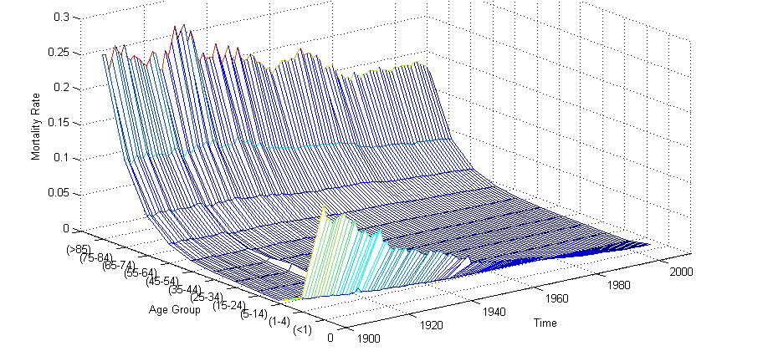
Data
Figure 1. 1900-2004 Mortality Rate

Slide 11
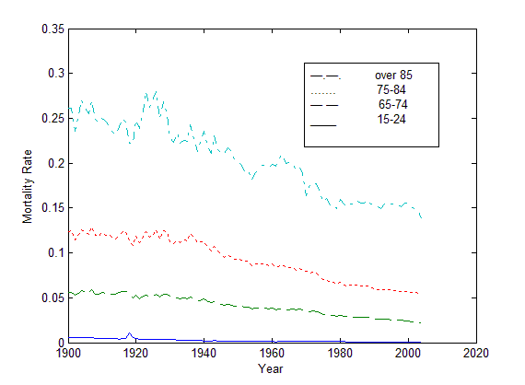
Data
Figure 2. Comparison of the Age Group Mortality Rates

Slide 12
Model Framework
Lee-Carter Framework
  Mortality improvement
  Different improvement rate for age groups
  Dynamic improvement trend
Model Set-up

Slide 13
Model Framework
Two-stage procedure Single Value Decomposition (SVD) method
  Regression
  Re-estimate

Slide 14
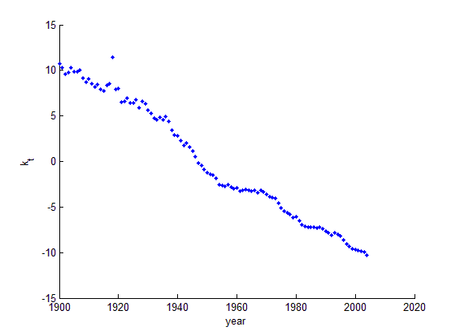
Model Framework

Slide 15
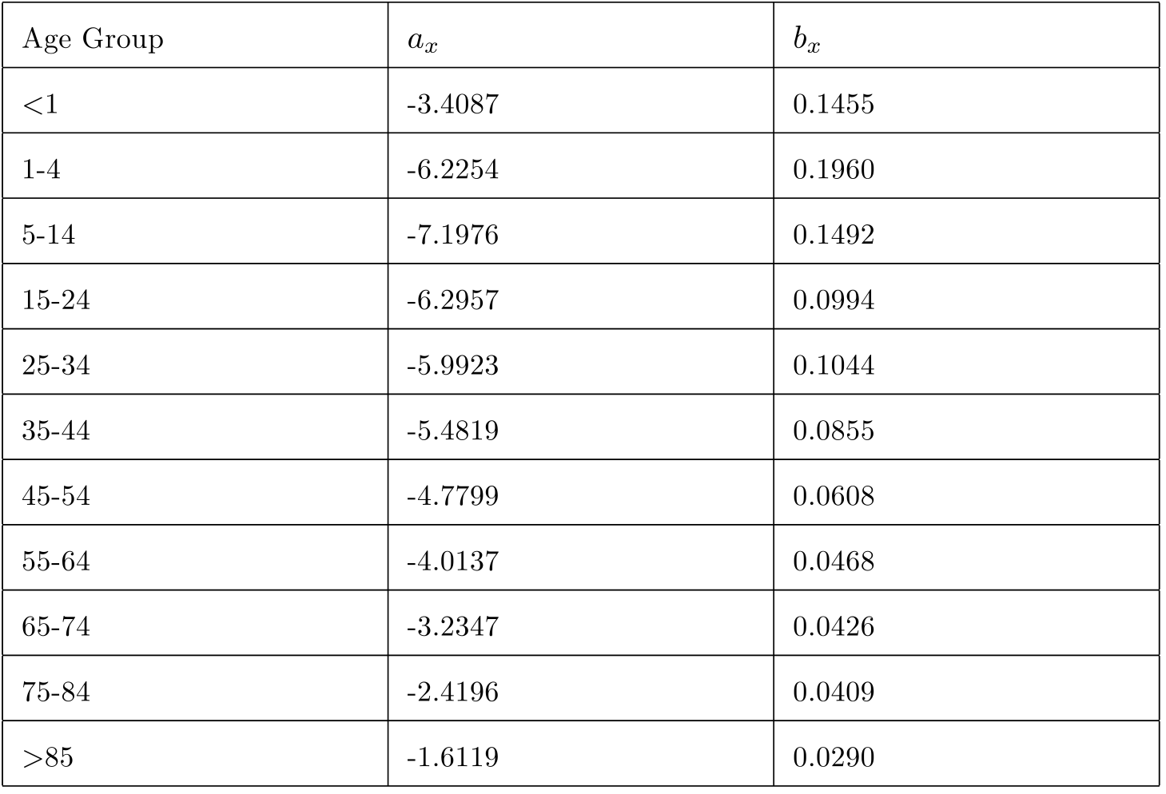
Model Framework

Slide 16
Model Requirement
Stochastic Process
Brownian Motion
Transient Jump
Asymmetric Jump
Non stochastic process
Geometric Brownian Motion
Permanent Jump
Symmetric Jump
V.S.
Asymmetric Jump
Phenomenon
Mortality Jump
  Short-term intensified effect
  Pandemic influenza, like flu 1918
Longevity Jump
  Long-term gentle effect
  Pharmaceutical or medical innovation
Compound Poisson-
Double Exponential Jump Diffusion
Positive Jump
  Small frequency
  Large scale
Negative Jump
  Large frequency
  Small scale

Slide 17
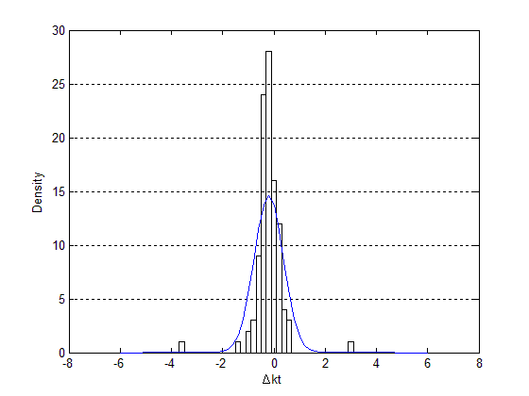
Model Requirement
The descriptive statistics of
shows asymmetric leptokurtic features.
The skewness of equals to -0.451
distribution is skewed to the left
distribution has a higher peak and two heavier tails
Figure 4. Comparison of actual distribution and normal distribution

Slide 18
Model Specification
Specification
Features
Differentiating positive jumps and negative jumps
Mathematical tractability
Closed-form formula
Concise
Widely implemented

Slide 19
Model Specification

Slide 20
Numerical Calculation
Parameter calibration
  Disentangling jumps from diffusion
  Maximum Likelihood Estimation method
  The form of the DEJD process satisfies the requirement of the transition density for using MLE
  Calibrate parameters
  Results indicates
  Maximum likelihood value

Slide 21
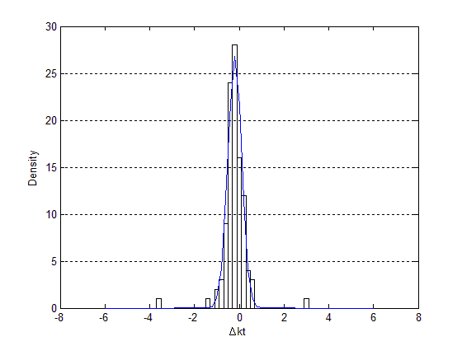
Model Comparison
Figure 4. Comparison of Actual Distribution and Normal Distribution
Figure 5. Comparison of Actual Distribution and DEJD Distribution

Slide 22
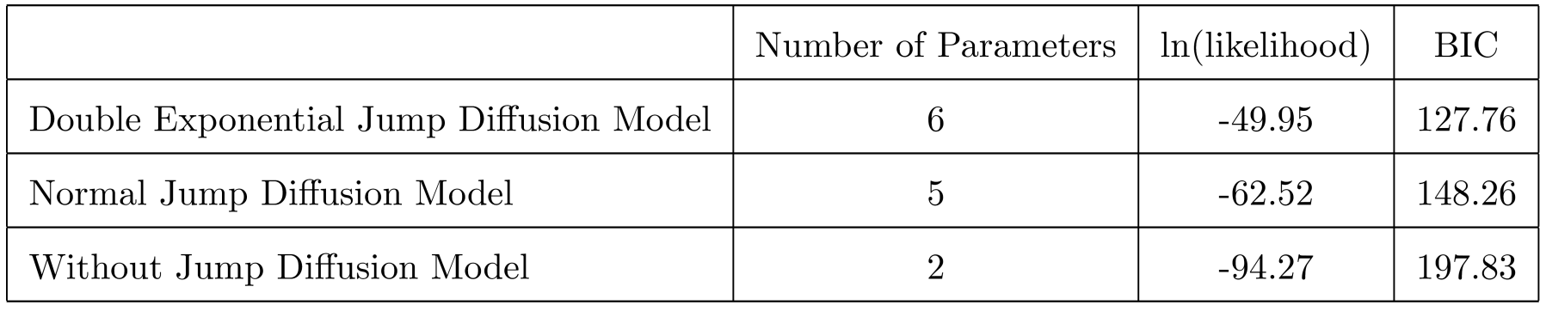
Model Comparison
Compare fitness of DEJD model with Lee-Carter Brownian Motion model and Normal Jump Diffusion model (Chen and Cox, 2009)
Bayesian Information Criterion (BIC)
  Allow comparison of more than two models
  Do not require alternative to be nested
  Conservative, heavily penalize over parameterization
  The smaller BIC, the better fitness
Table 2. Comparison of model fitness

Slide 23
Implied Market Price of Risk
Swiss Re Mortality Catastrophe Bond is issued by the Swiss Reinsurance company , as the first mortality risk contingent securitization in Dec. 2003
The bond is issued through a special purpose vehicle (SPV), triggered by a catastrophe evolution of death rates of a certain population
The bond has a maturity of three years, a principal of $400m, the coupon rate of 135 basis points plus the LIBOR
The precise payment schedules are given by the following function:

Slide 24
Risk-Neutral Pricing
Risk-neutral method by Milevsky and Promislow (2001) and Cairns, Blake, and Dowd (2006a)
The method is derived from the financial economic theory that posits even in an incomplete market
No arbitrage ➔ At least one risk-neutral measure
Linear transform instead of the distorted transform function
Market prices of risk set

Slide 25
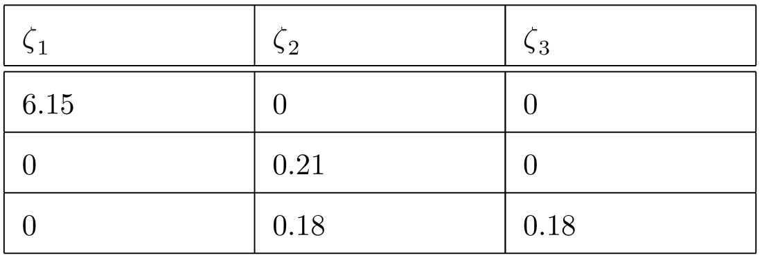
Risk-Neutral Pricing
Table 4. Implied Market Prices of Risk by Risk-Neutral Transform

Slide 26
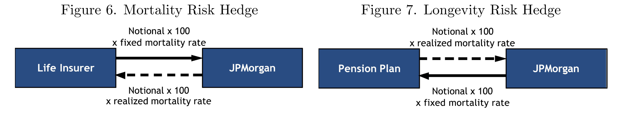
q-Forward
Basic building blocks
  Standardized contracts for a liquid market
Exchange
  realized mortality of a population at some future date,
  a fixed mortality rate agreed at inception
Pension funds
  hedge against increasing life expectancy of plan members,
  the longevity risk
Life insurers
  hedge against the increase in the mortality of policyholders,
  the mortality risk

Slide 27
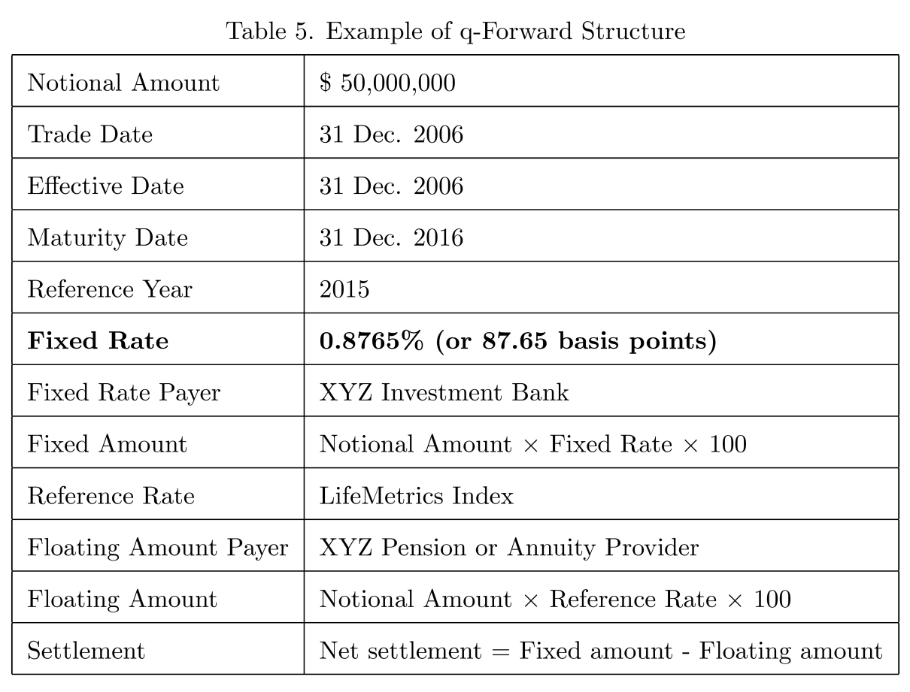
q-Forward Pricing
The fixed rate can be calculated with the closed-form formula directly.

Slide 28
Conclusion
Model
  Quantify and measure the longevity risk and mortality risk
  Forecast the future mortality rate and life expectancy
Impact
  Manage longevity risk for pension funds and annuity providers
  Manage mortality risk for life insurers
  Price mortality rate linked securities
    Catastrophe bonds
    Longevity bonds
    Life-settlement securities
    Annuities
Contribution
  Incorporate underlying reasons (stochastic, cohort effect, jump effect)
  Goodness of fit
  Mathematical tractability
  Easy calibration and implementation
  Concise, neat and practical

Slide 29
Thank you

